Slide 1
Build your own experiment with Azure Machine Learning Studio
Pardali Christina, MSP

Slide 2

Agenda
AI and Machine Learning
Supervised Learning
Microsoft Azure
Azure Machine Learning Studio
Train your model demo
Resources

Slide 3

AI and Machine Learning

Slide 4

Machine Learning and types
It is a branch of artificial intelligence based on the idea that systems can learn from data, identify patterns and make decisions with minimal human intervention.
Types of Machine learning:
Supervised Learning
Unsupervised Learning
Reinforcement Learning
Recommender Systems

Slide 5
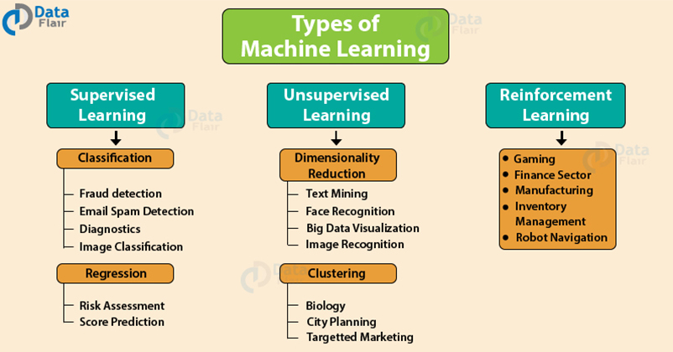
Methods of Machine Learning

Slide 6
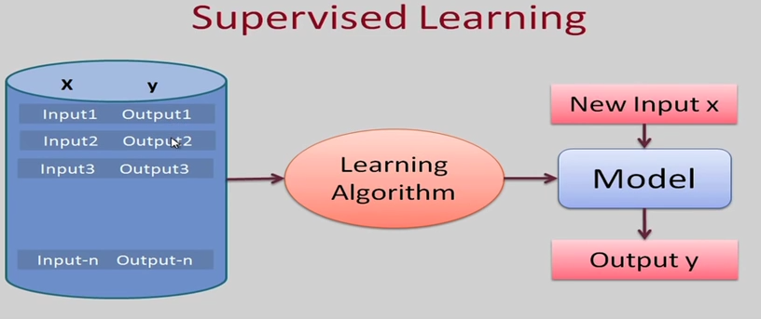
Supervised Learning

Slide 7
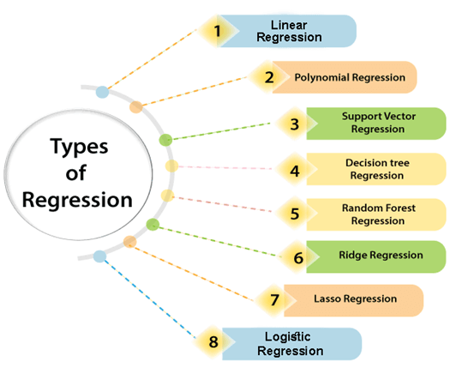

Slide 8
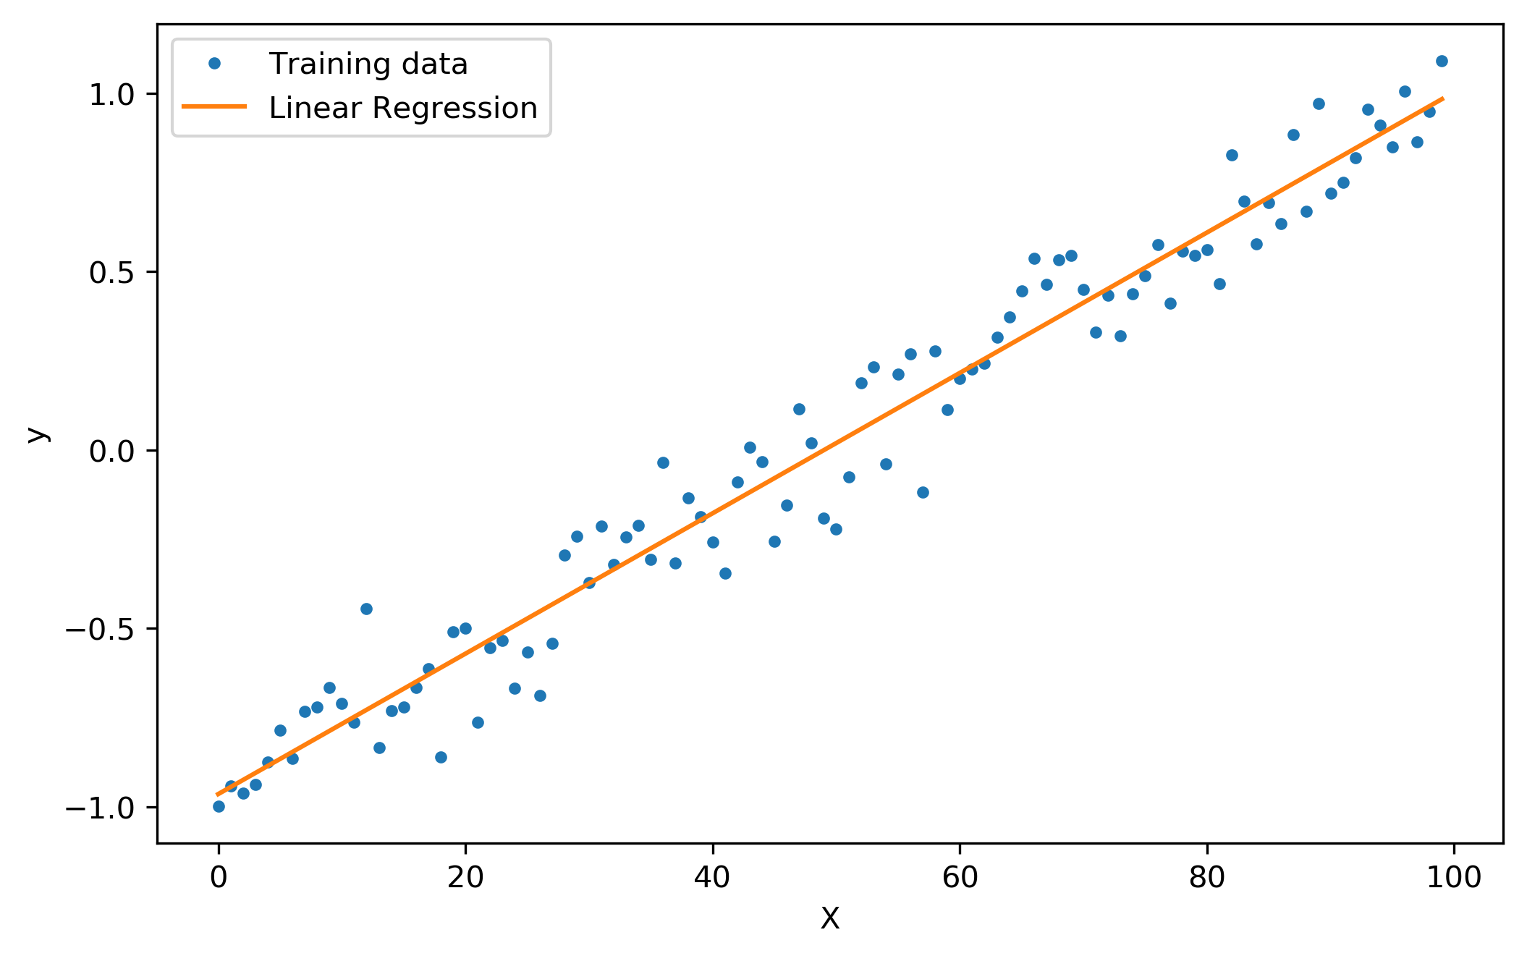
Linear Regression
Simple Linear Regression
Υ=c1+c2*x
Multiple Linear Regression
Y=c1+c2*x1+c3*x3+c4*x4
Simple Linear Regression

Slide 9
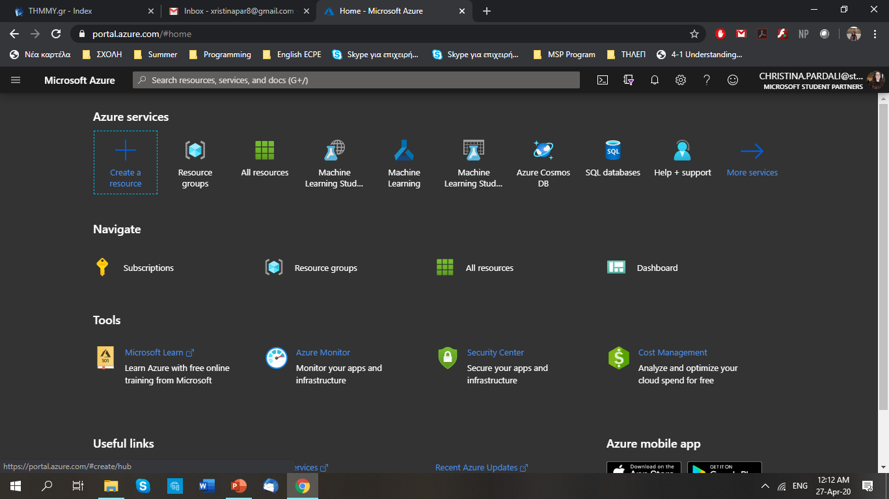
Microsoft Azure
Microsoft Azure is a cloud computing service created for building, testing, deploying, and managing applications and services through Microsoft-managed data centers.

Slide 10
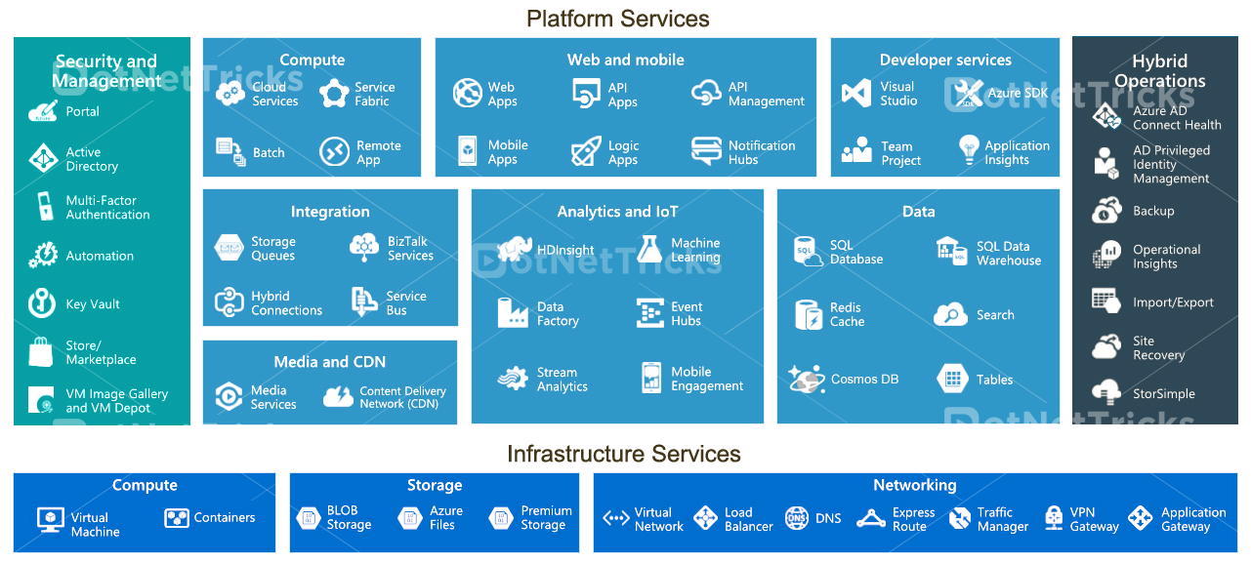
Microsoft Azure

Slide 11

Azure Machine Learning Studio
Microsoft Azure Machine Learning Studio (classic) is a collaborative, drag-and-drop tool you can use to build, test, and deploy predictive analytics solutions on your data.
https://studio.azureml.net/

Slide 12
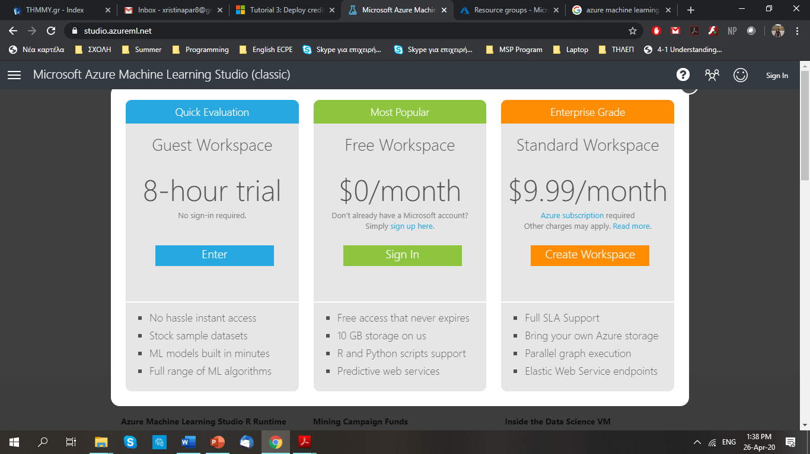
Subscription in ML Studio

Slide 13



Model workflow
Preprocess the data
Build and train the model
Run the model

Slide 14
Demo time

Slide 15
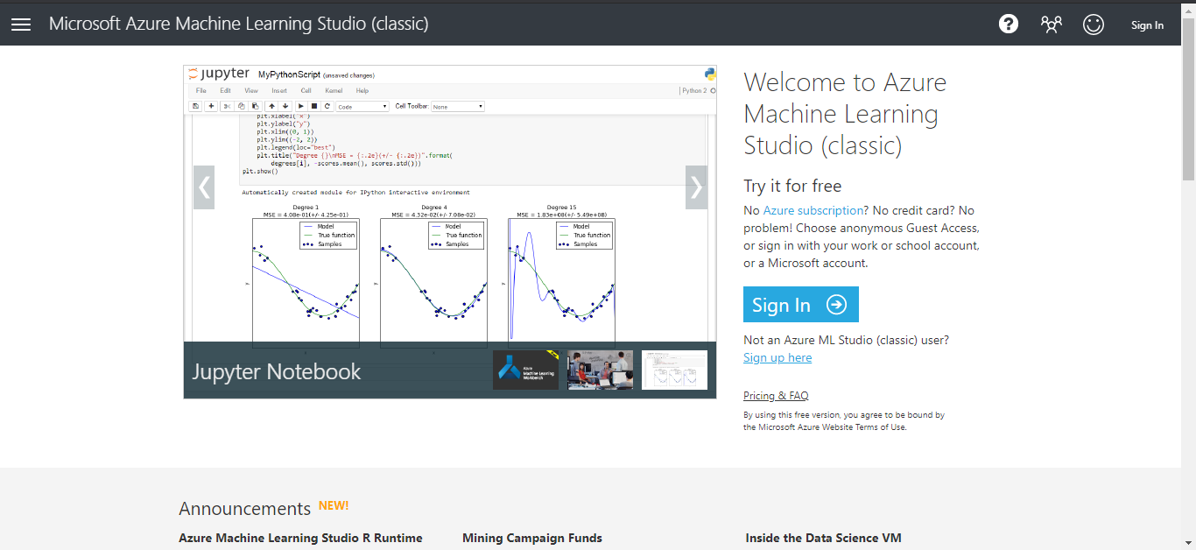

Slide 16
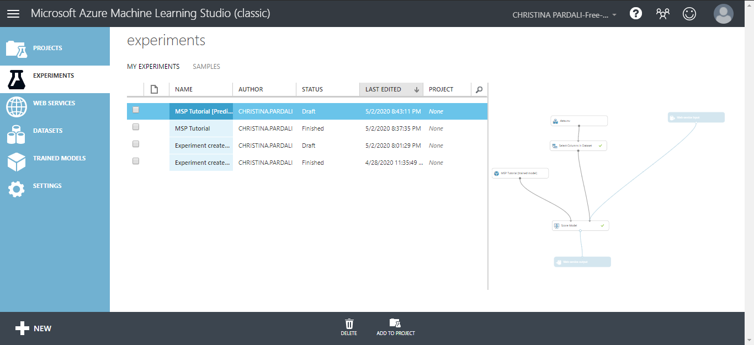

Slide 17
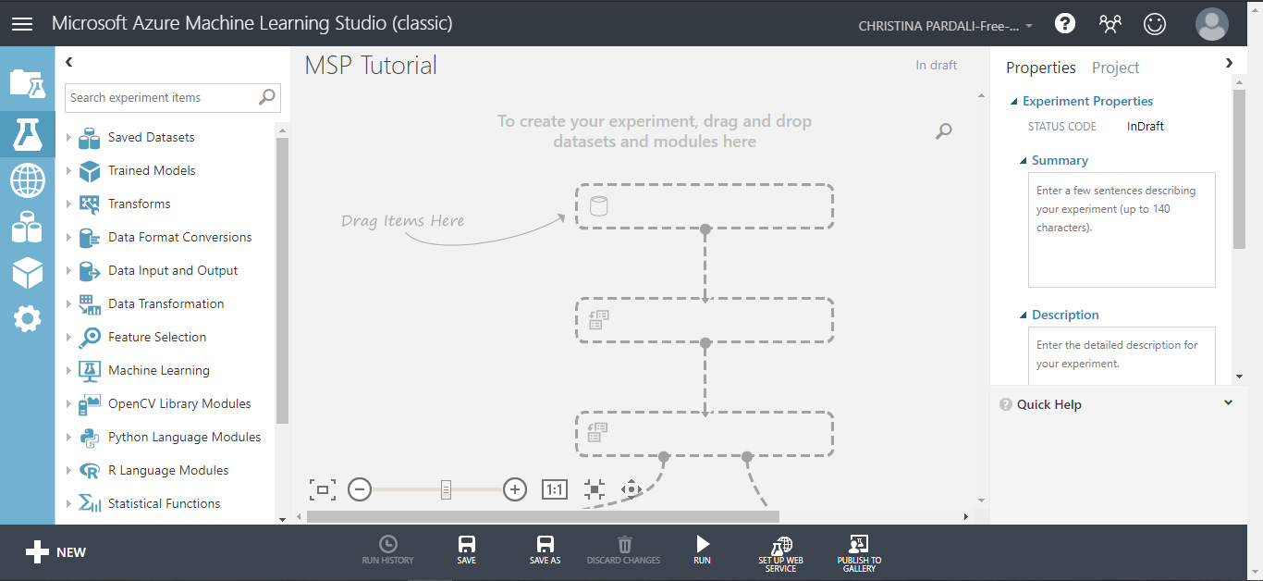

Slide 18
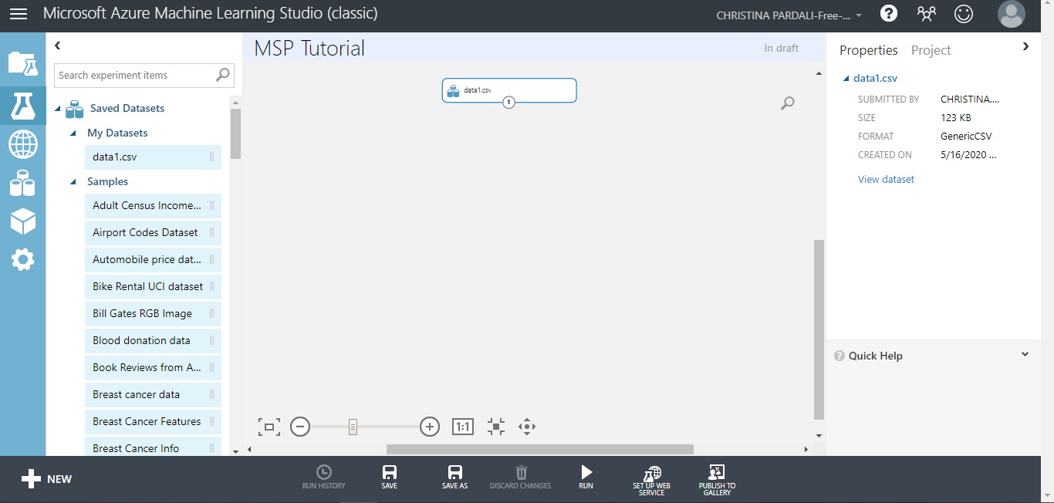

Slide 19
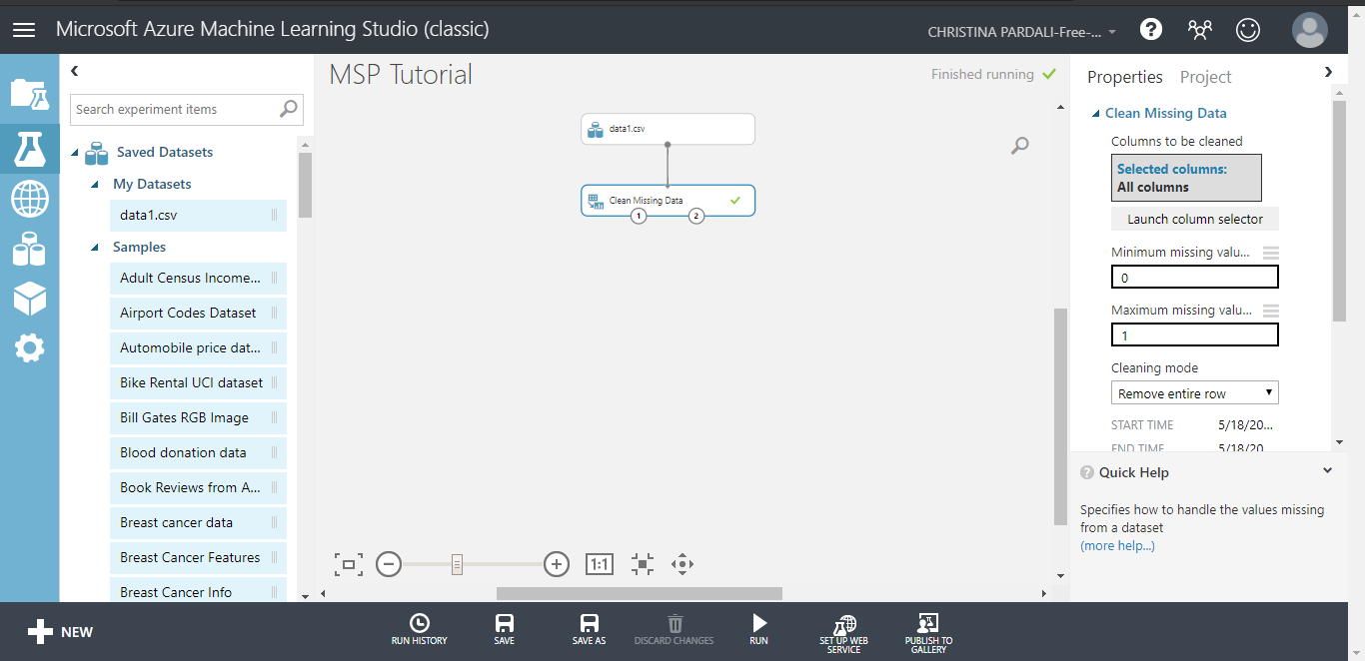

Slide 20
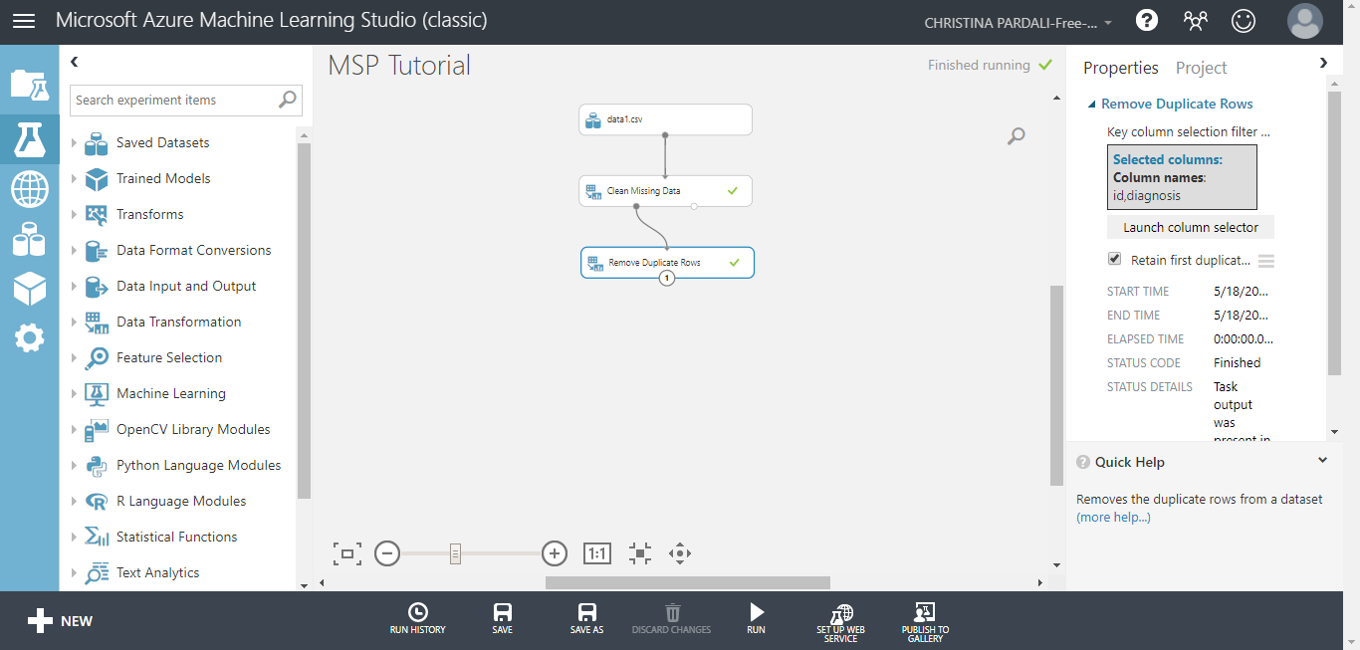

Slide 21
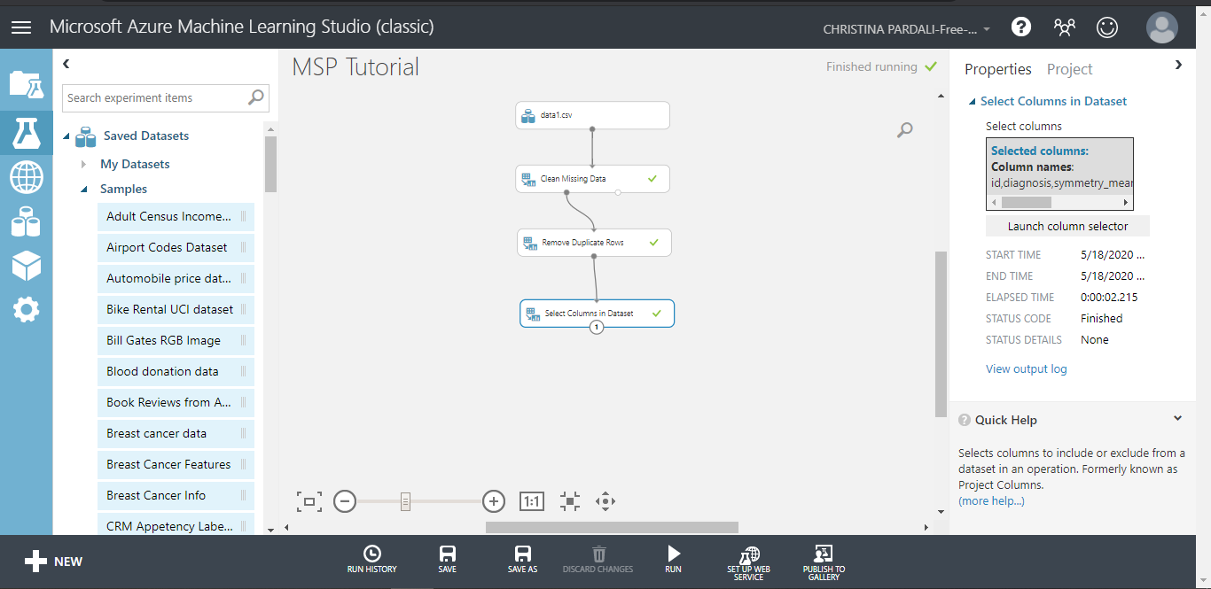

Slide 22
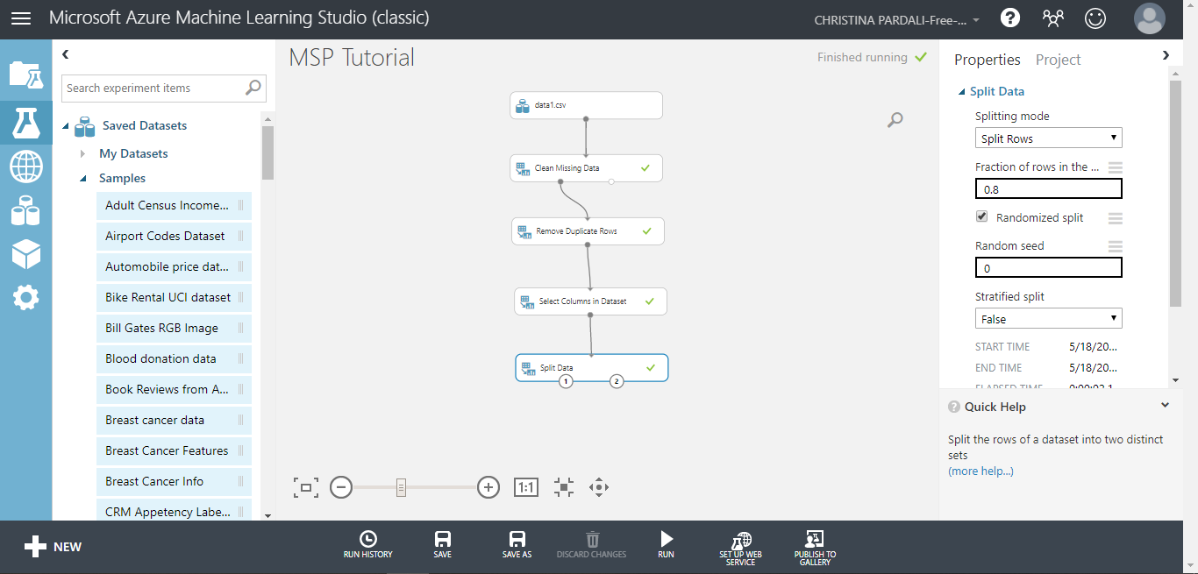

Slide 23
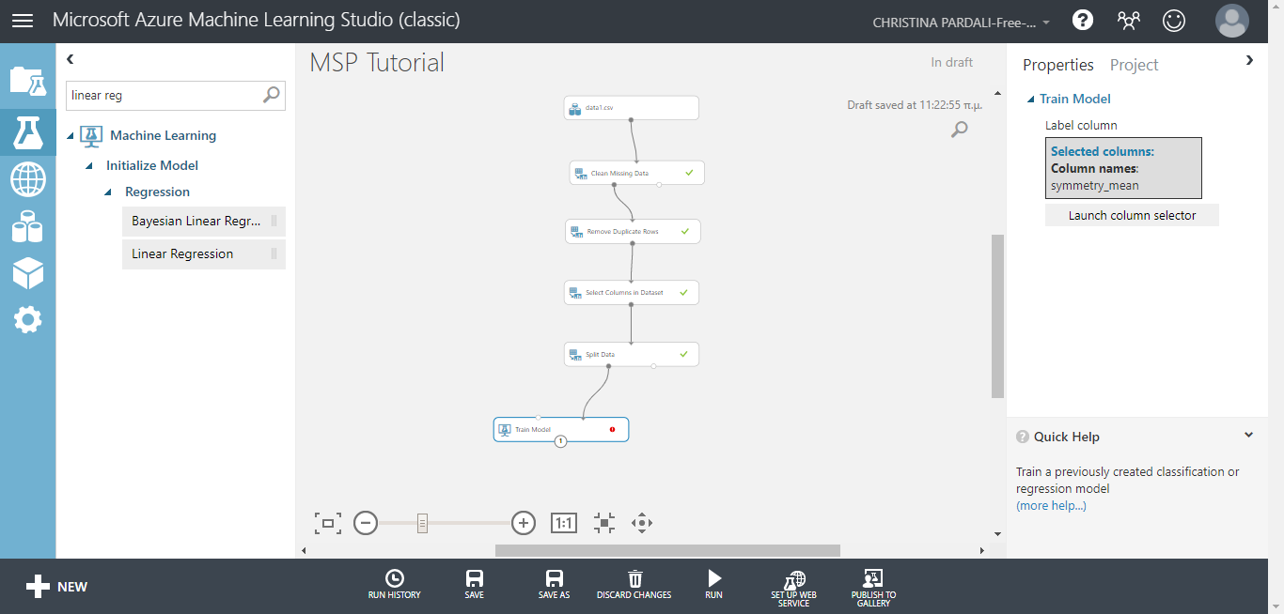

Slide 24
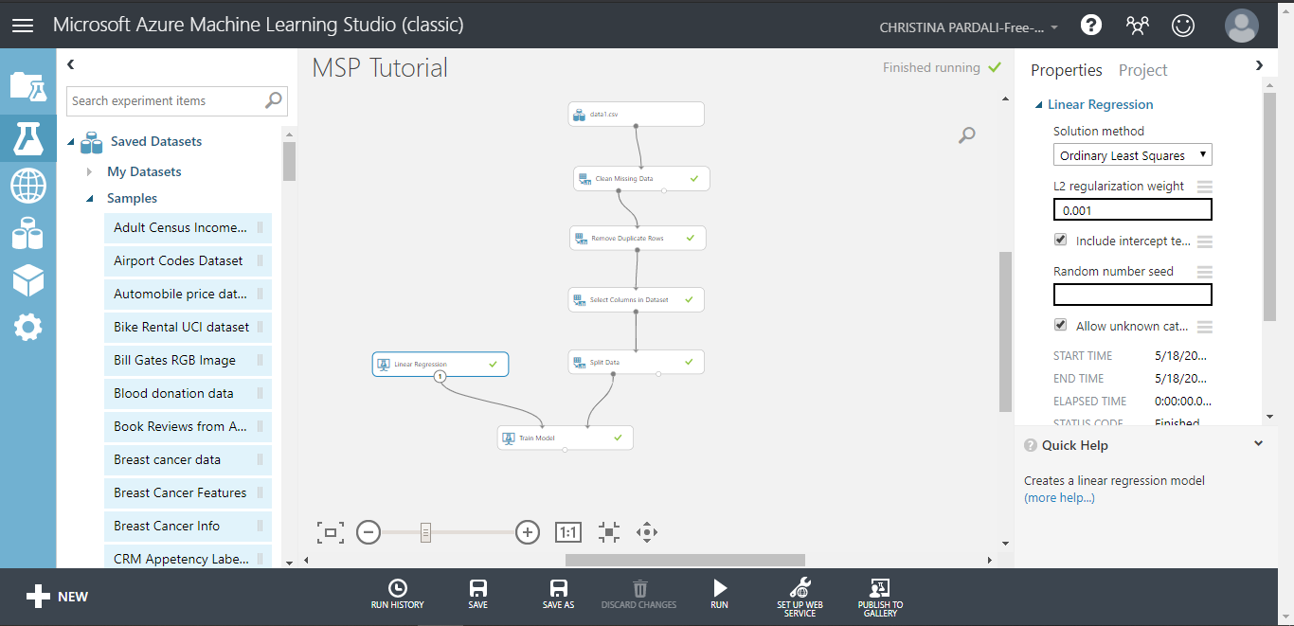

Slide 25
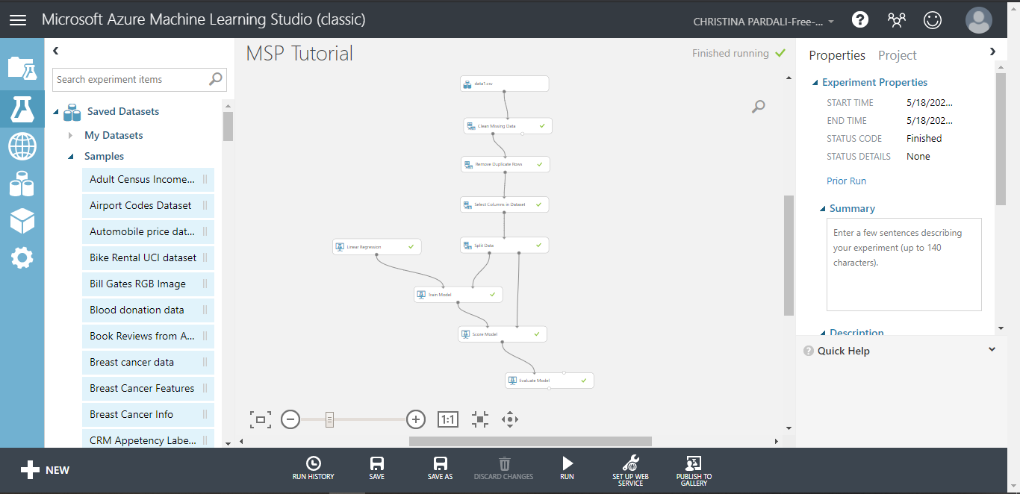

Slide 26
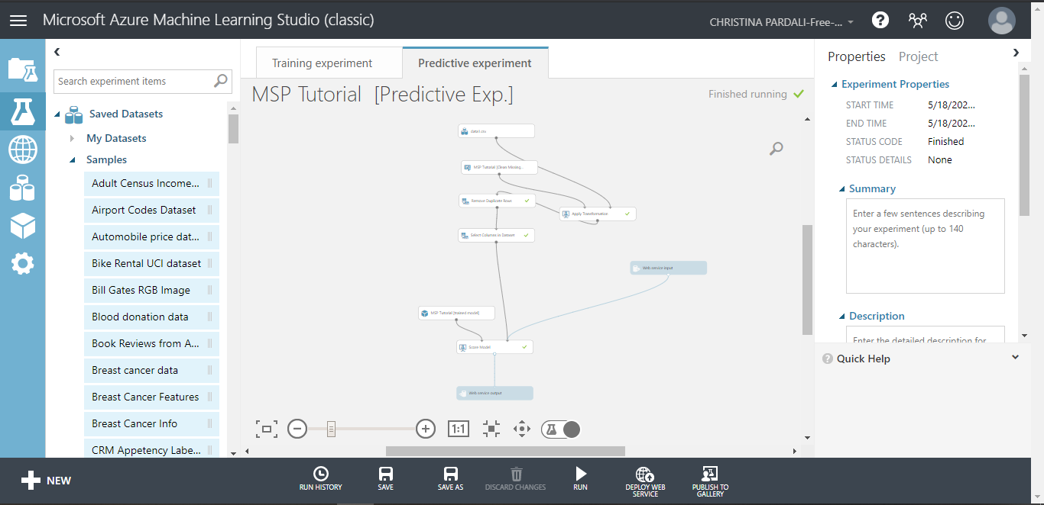

Slide 27
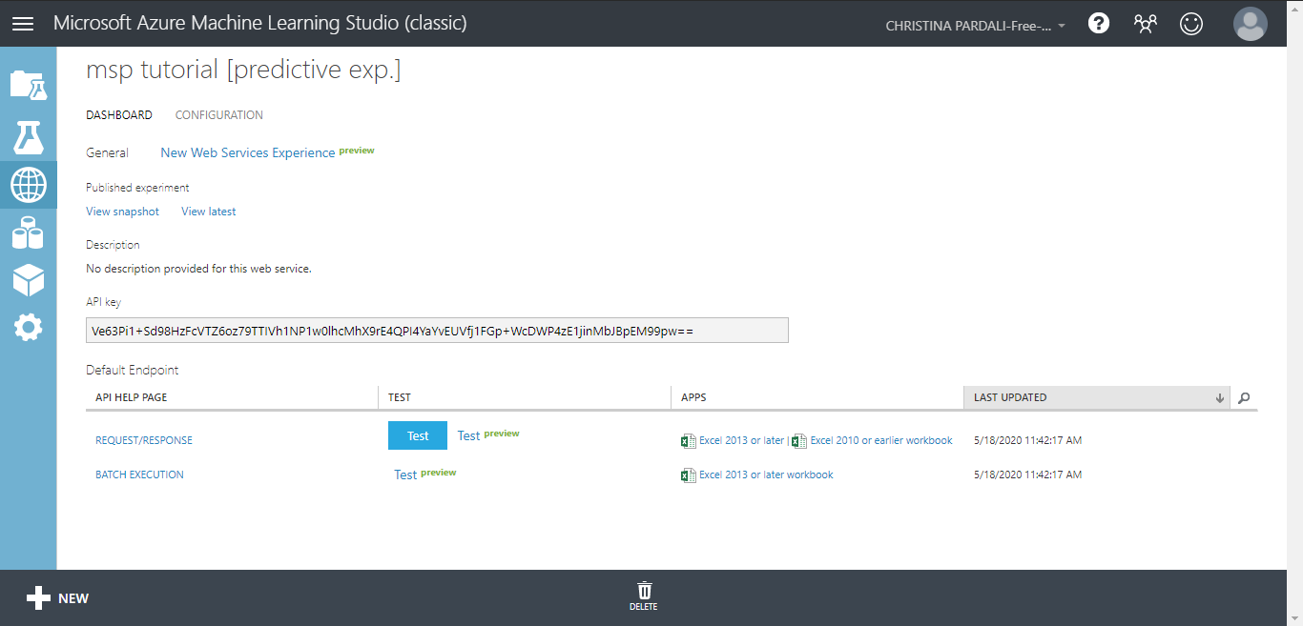

Slide 28
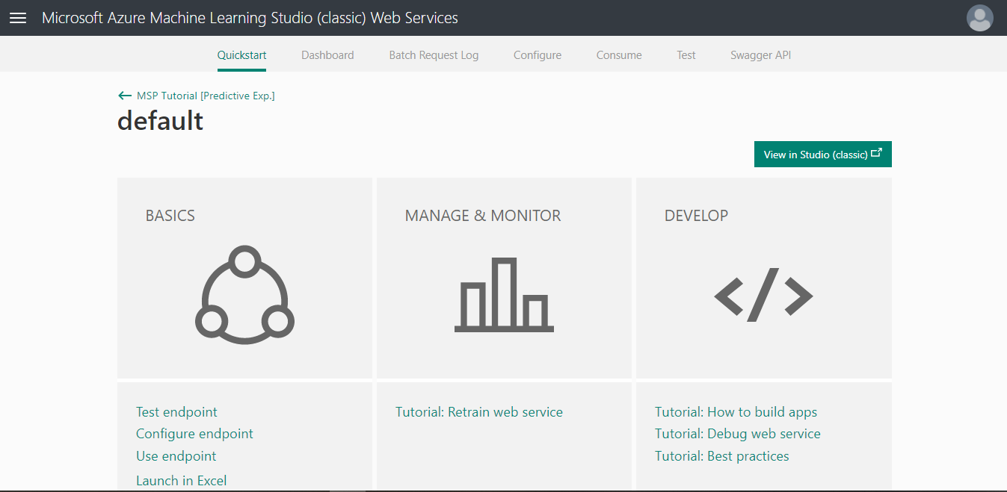

Slide 29
Resources
Microsoft Azure : https://azure.microsoft.com/
Microsoft Machine Learning Studio: https://studio.azureml.net/
Microsoft Docs for learning tutorials : https://docs.microsoft.com/

Slide 30
Find us on social media
Microsoft Student Partners Thessaloniki : https://www.facebook.com/SG.Thessaloniki/
Github account of SG Thessaloniki : https://github.com/SGThessaloniki
Microsoft Student Partners Greece : https://www.facebook.com/mspgreece/
Microsoft Student Partners CEE : https://www.facebook.com/mspcee/
Microsoft Student Partner Program : https://studentpartners.microsoft.com/

Slide 31
Thank you!

